Slide 1


INSIGHTS INTO HOUSING MARKETS IN HO CHI MINH CITY
Students: Vo Thanh An
Nguyen Hoang Phuc Huy
Advisor: Dr. Nguyen Van Vu

Slide 2
Outline
Introduction
Background
Approach
Conclusion and Future Work

Slide 3
Introduction

Slide 4
Real Estate Market Overview

Slide 5
Motivation

Slide 6
Objective
A system that:
1. Automatically collect real estate data from various resources
2. Analyze data and provide an insight about the housing market in real-time

Slide 7

Background

Slide 8
Approach
Data Cleaning
Data Visualization
Data Analysis
Data Crawling

Slide 9
Data Crawling
Scrapy: Python Web Crawling Framework

Slide 10

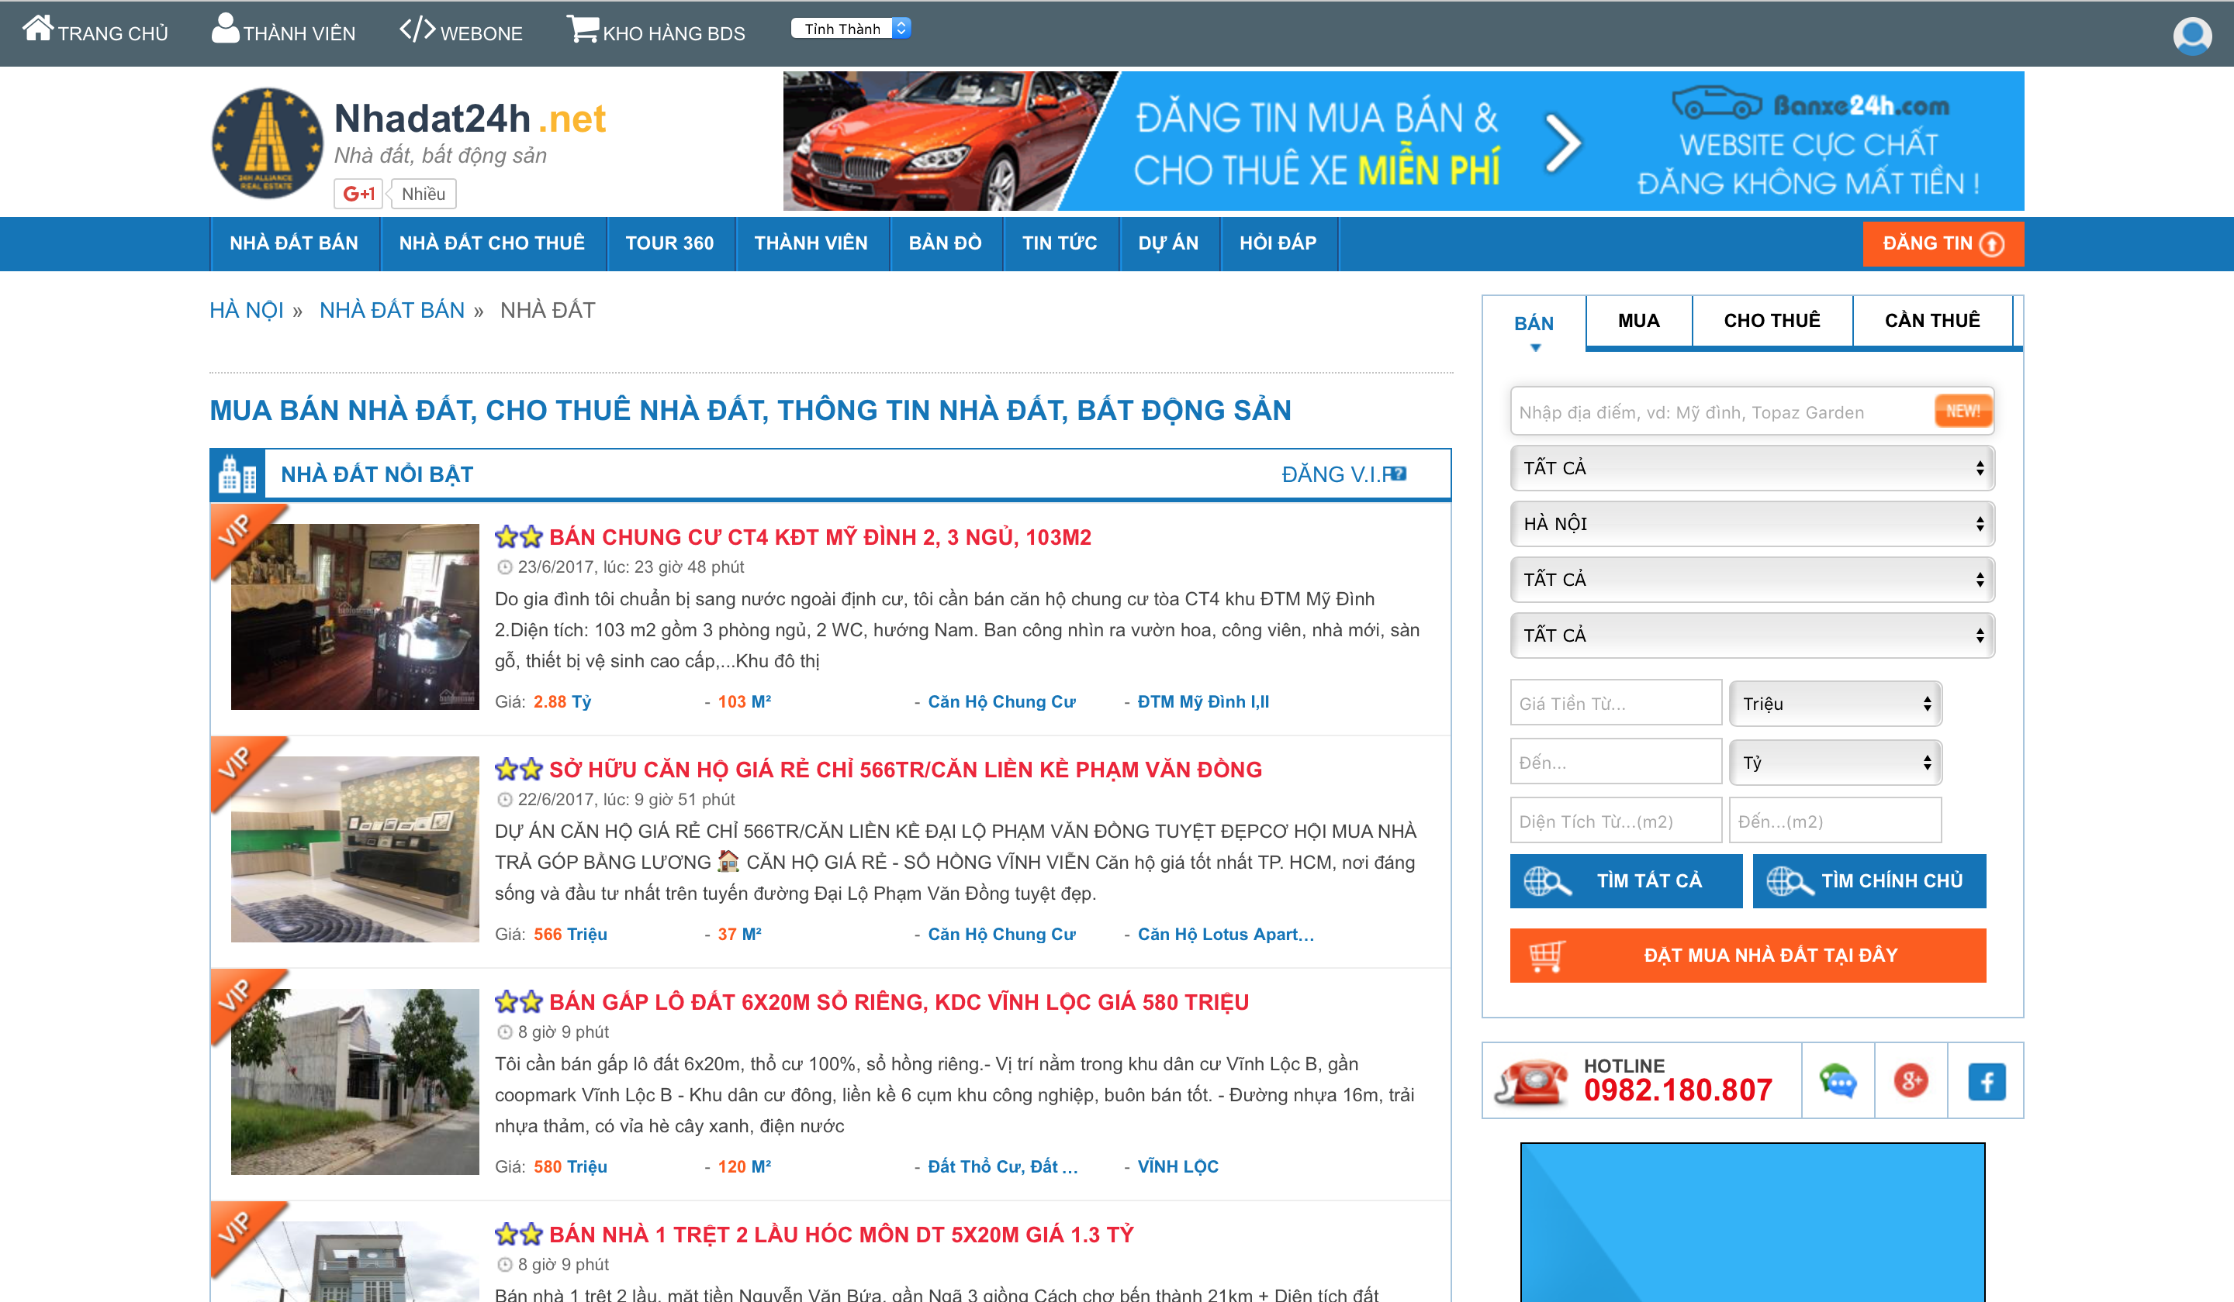
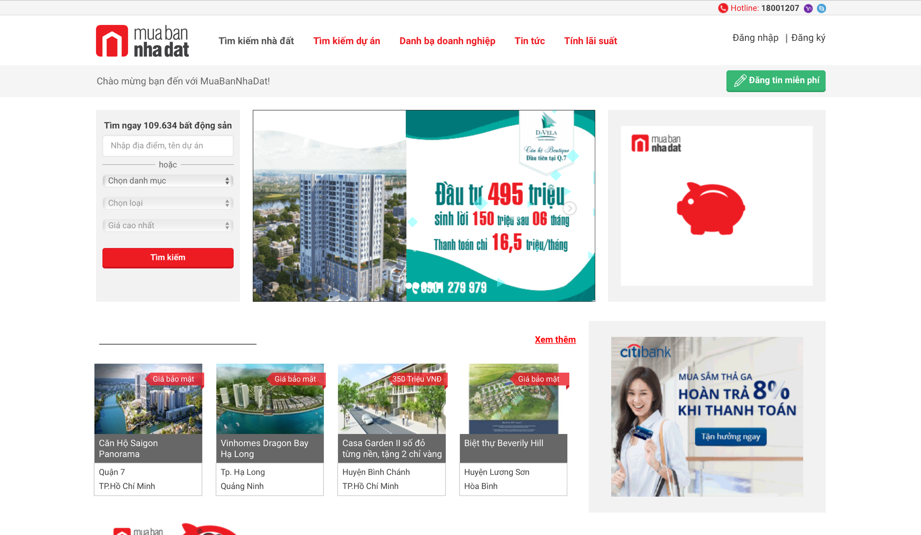
Data Crawling
Real Estate Websites for Data Crawling:
www.muabannhadat.vn
www.alonhadat.vn
www.nhadat24h.net
www.123nhadat.vn
www.batdongsan.com.vn
www.diaoconline.vn

Slide 11
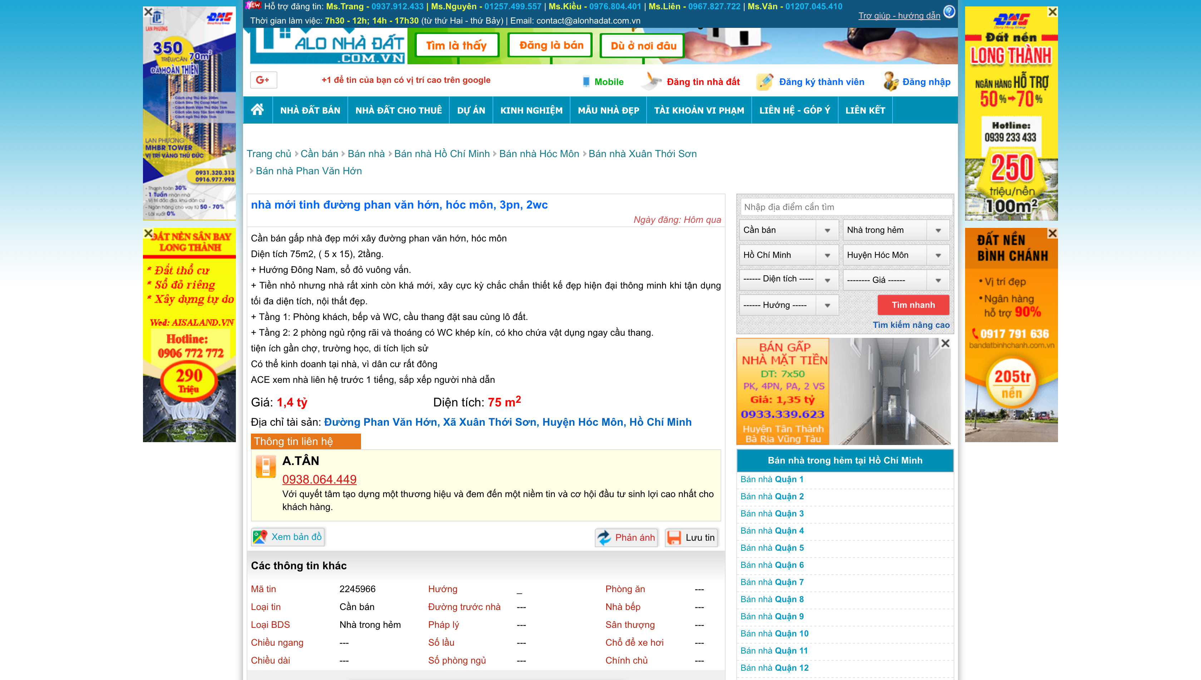
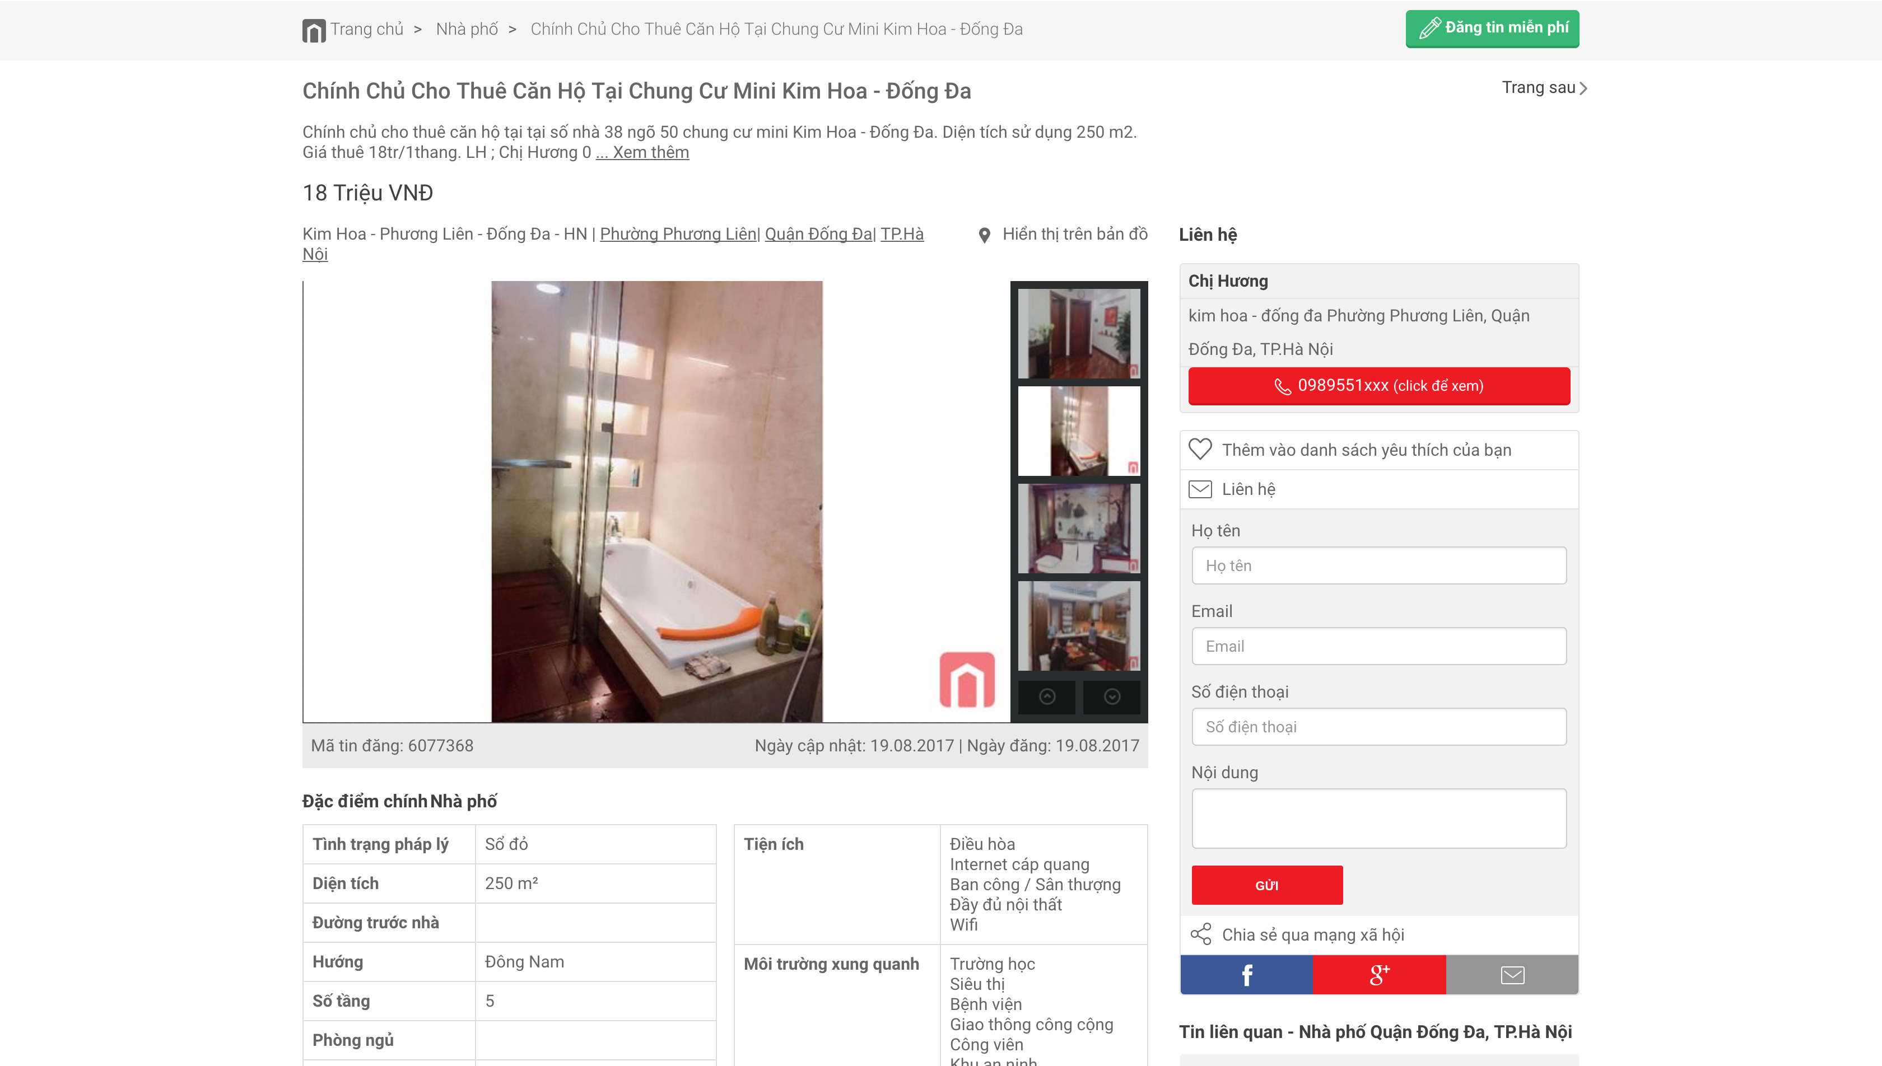
Data Storage Format
ID: post’s ID
Title: post’s title
Location: road, ward, county, city
Author: house’s owner
Post-time: posting time
Project: name of the apartment
Price: price of the house
Transaction-type: sale or rent
House-type: villa, apartment, townhouse …
Description: house discription

Slide 12
Merging Data From Multiple Sources
Every website has its own format. Human can read but system cannot.
Ex: Ho Chi Minh (muabannhadat.vn) vs HCM(alonhadat.vn) vs TP Ho Chi Minh(batdongsan.com.vn
Merging Data:
Hotel, Restaurant
Hotel, Motel
Hotel, Restaurant, Motel
Hotel

Slide 13
Data Grouping

Slide 14
Data Cleaning
Duplication Removal

Slide 15
Data Cleaning
Unreasonable Value Removal

Slide 16
Conclusion Future Work

